Slide 1

CSR EVOLUTION AND GOVERNMENT POICIES
Career Development Centre
SRMIST – kattankulathur

Slide 2

CSR- Corporate Social Responsibility
CSR is a concept whereby companies not only consider their profitability and growth, but also the interests of society and the environment
Career Development Centre
SRMIST – kattankulathur

Slide 3

CSR takes responsibility
For the impact of their activities on
Stakeholders
Environment
Consumers
Employees
Communities, and
All other members of the public sphere.
Career Development Centre
SRMIST – kattankulathur

Slide 4

Corporate Social Responsibility is what an organisation does, to positively influence the society in which it exists.
It could take the form of community relationship
Volunteer assistance programmes
Special scholarships
Preservation of cultural heritage and beautification of cities.
Career Development Centre
SRMIST – kattankulathur

Slide 5
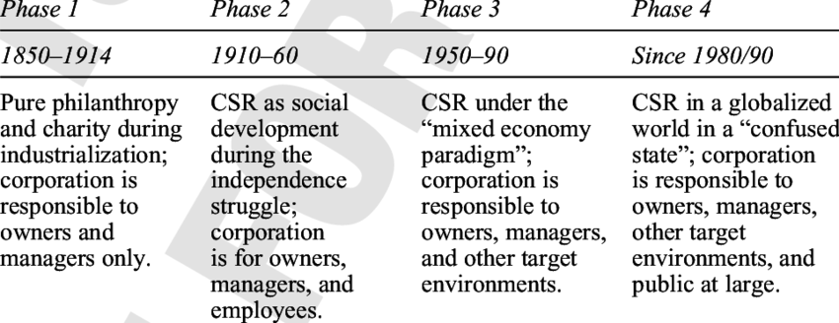
CSR-EVOLUTION
Career Development Centre
SRMIST – kattankulathur

Slide 6
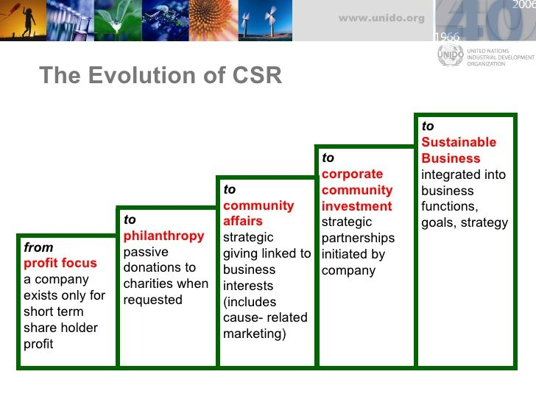
Career Development Centre
SRMIST – kattankulathur

Slide 7
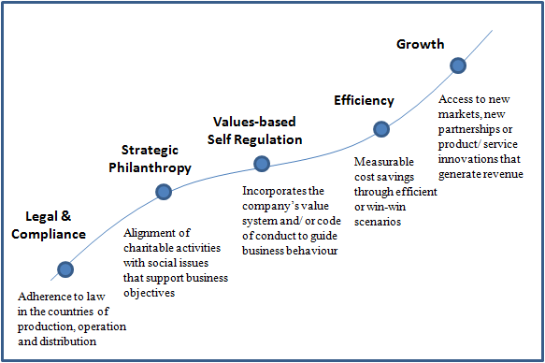
Career Development Centre
SRMIST – kattankulathur

Slide 8

CSR creates a favourable public image, which attracts customers.
Organizations that perform well with regard to CSR can build reputation
Brand equity, is founded on values such as trust, credibility, reliability, quality
Employees like to contribute to the cause of creating a better society.
Employees become champions of a company for which they are proud to work and consistency.
Career Development Centre
SRMIST – kattankulathur

Slide 9
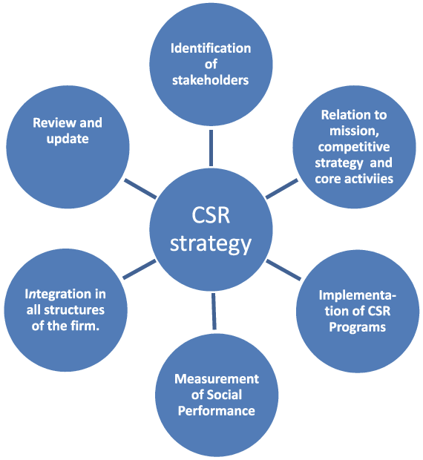
The internal activities of the organisation have an impact on the external environment, since the society is an interdependent system.
A business organisation has a great deal of power and money, entrusted upon it by the society and should be accompanied by an equal amount of responsibility. In other words, there should be a balance between the authority and responsibility.
Companies can better address the grievances of its employees and create employment opportunities for the unemployed.
A company with its “ear to the ground” through regular stakeholder dialogue is in a better position to anticipate and respond to regulatory, economic, social and environmental changes that may occur.
Career Development Centre
SRMIST – kattankulathur

Slide 10

The Corporate Social Responsibility Voluntary Guidelines
Career Development Centre
SRMIST – kattankulathur

Slide 11

Ministry urged the business sector to adopt the principles contained in the Guidelines for responsible business practices
The document also said that “after considering the experience of the adoption of these Guidelines by the Indian corporate sector and consideration of relevant feedback and other related issues,
The Government may initiate the exercise for review of these Guidelines and further improvement after one year.
Career Development Centre
SRMIST – kattankulathur

Slide 12
The Companies Act, 2013 has introduced the concept of Corporate Social Responsibility in India.
It aims to promote greater transparency and disclosure.
The Ministry of Corporate Affairs notified Section 135 and Schedule VII of the Companies Act 2013
As well as the Companies (Corporate Social Responsibility Policy) Rules, 2014 which came into effect from April 1, 2014.
Career Development Centre
SRMIST – kattankulathur

Slide 13
Notification making further amendments in Schedule VII was issued on August 2014 and Companies (Corporate Social Responsibility Policy).
Amendment Rules, 2015 were released on January 2015.
The Board of Directors shall make sure that the company spends in every financial year, minimum 2% of the average net profits made during the 3 immediately preceding financial years as per CSR policy.
Career Development Centre
SRMIST – kattankulathur

Slide 14
Corporate Social Responsibility Under Section 135 of Companies Act 2013
APPLICABILITY
The provisions of CSR applies to
Every company
Its holding company
Its subsidiary company
Foreign company
Having in the preceding financial year
Net Worth > 500 Crore
Turnover > 1000 Crore
Net Profit > 5 Crore
Career Development Centre
SRMIST – kattankulathur

Slide 15
The Corporate Services Division delivers these responsibilities through several institutionalised bodies:
• Tata Steel Corporate Social Responsibility and Accountability Policy
• Corporate Social Responsibility
• Tata Steel Rural Development Society (TSRDS)
• Tribal Cultural Society (TCS)
• Tata Steel Family Initiatives Foundation (TSFIF)
• Tata Steel Skill Development Society (TSSDS)
• Education
• Medical Services
• Urban Services
• Sports Department
Career Development Centre
SRMIST – kattankulathur

Slide 16

Here are the Top 10 Indian companies for CSR in 2019.
Tata Chemicals tops list of Indian companies for CSR
Infosys Ltd
Bharat Petroleum Corporation Ltd
Mahindra & Mahindra Ltd
ITC Ltd
Ambuja Cement Ltd
Tata Motors Ltd
Vedanta Ltd
Hindalco Industries Ltd
Toyota Kirloskar Motor India
Career Development Centre
SRMIST – kattankulathur

Slide 17
Thank you!
Career Development Centre
SRMIST – kattankulathur

